Slide 1

Sentiment-Driven Topic Analysis in ISIS Tweets: Exploring Sentiment-Topic Pairs through Semi-Supervised and Unsupervised LDA Detecting and countering harmful narratives 6 Nov 2024
Group 2
Lorielle Angelei Villegas Malveda: lav.malveda.2023@mitb.smu.edu.sg
Huang Shaofei: sf.huang.2023@engd.smu.edu.sg
Goh Cheng En: chengen.goh.2023@mitb.smu.edu.sg
Low Wei Jun: weijun.low.2023@mitb.smu.edu.sg
Sarthak Jagdish Nagapurkar: sarthakj.n.2023@mitb.smu.edu.sg
Liang Xiuhao: xh.liang.2023@mitb.smu.edu.sg
Notes:
My team and I will present how text analytics using sentiment and topic analysis can help detect and counter harmful narratives.

Slide 2



BACKGROUND AND MOTIVATIONS
BACKGROUND
The rise of social media has provided a platform for free expression of views on both positive and negative communication.
Extremist groups, such as ISIS, leverage platforms like X (formerly known as Twitter) to spread their propaganda, recruit members, and coordinate activities.
MOTIVATIONS
Early Detection of Extremist Messaging
Improved Content Moderation
Strategic Countermeasures
​POTENTIAL USERS
Law Enforcement and Intelligence Agencies
Counter-Terrorism Agencies
Social Media Platforms
Notes:
In Singapore we have

Slide 3
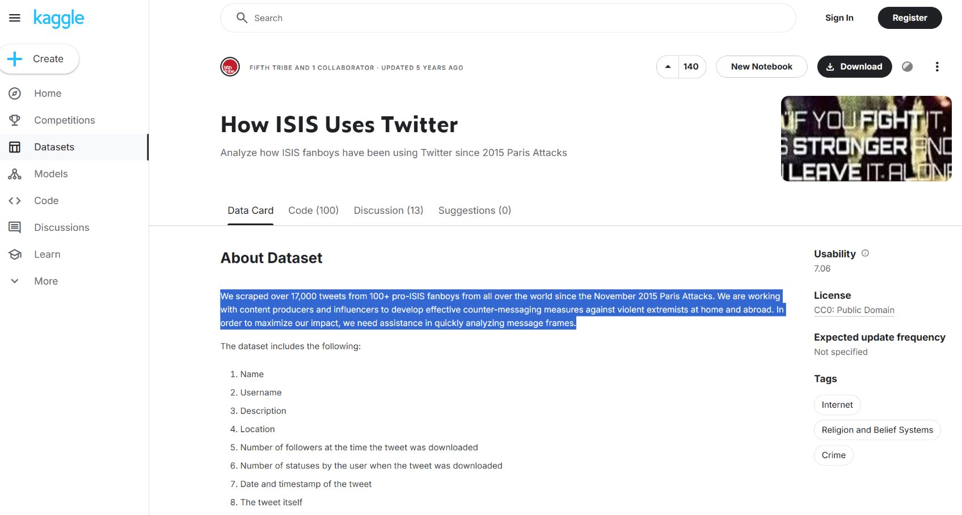
https://www.kaggle.com/datasets/fifthtribe/how-isis-uses-twitter

Slide 4
PROJECT OBJECTIVES AND TASKS
The main objective of this project is to perform sentiment and topic analysis on the isis-related tweets dataset.
From this classification, tweets will undergo further analysis to determine if they fall into more specific topics, such as :
The aim is to classify the tweets into three primary categories:
POSITIVE
NEGATIVE
NEUTRAL
PROPAGANDA
HATE
PLANNED ATTACKS
LATENT DIRICHLET ALLOCATION (LDA) a generative statistical model for text processing
by leveraging different tools such as
VADER, AFINN and a pre-trained BERTweet language model
for our analysis.
This deeper level of topic modelling cover the intent behind certain messages, especially those promoting extremist narratives or encouraging harmful activities.
Notes:
The dataset was from Kaggle with 17k+ tweets taken from 100+ pro ISIS fanboys from all over the world since the Nov 2015 Paris Attack

Slide 5
APPROACH AND RESEARCH METHODOLOGY
Data Pre-processing
Data cleaning and normalisation, exploratory data analysis (EDA), feature extraction using word embedding
Sentiment Analysis
Label tweets using VADER, AFINN and BERTweet into based on sentiments (Positive, Negative, Neutral), then performing additional EDA on respective results
Topic Modelling
(1) Semi-supervised learning with pre-defined seed topics in LDA.
(2) Unsupervised LDA
Analysis
Identify accounts and tweets that express pro-ISIS sentiments based on sentiment-topic pair.
Step 1:
Data Pre-Processing
Step 2:
Sentiment Analysis
Positive
Negative
Neutral
Step 3:
Topic Modelling
Positive Sentiment-Topic Pairs
Negative Sentiment-Topic Pairs
Neutral Sentiment-Topic Pairs
Step 4:
Analysis – Identifying Potential Risks

Slide 6
The dataset consists of 17,410 entries with the following columns:
name: name associated with the Twitter account
username: twitter handle
description: bio of the Twitter account
location: location of the user
followers: number of followers the account has
numberstatuses: number of tweets or statuses the account has posted
time: date/timestamp when the tweet was posted
tweets: content of the tweets
STEP 1: DATA PRE-PROCESSING

Slide 7
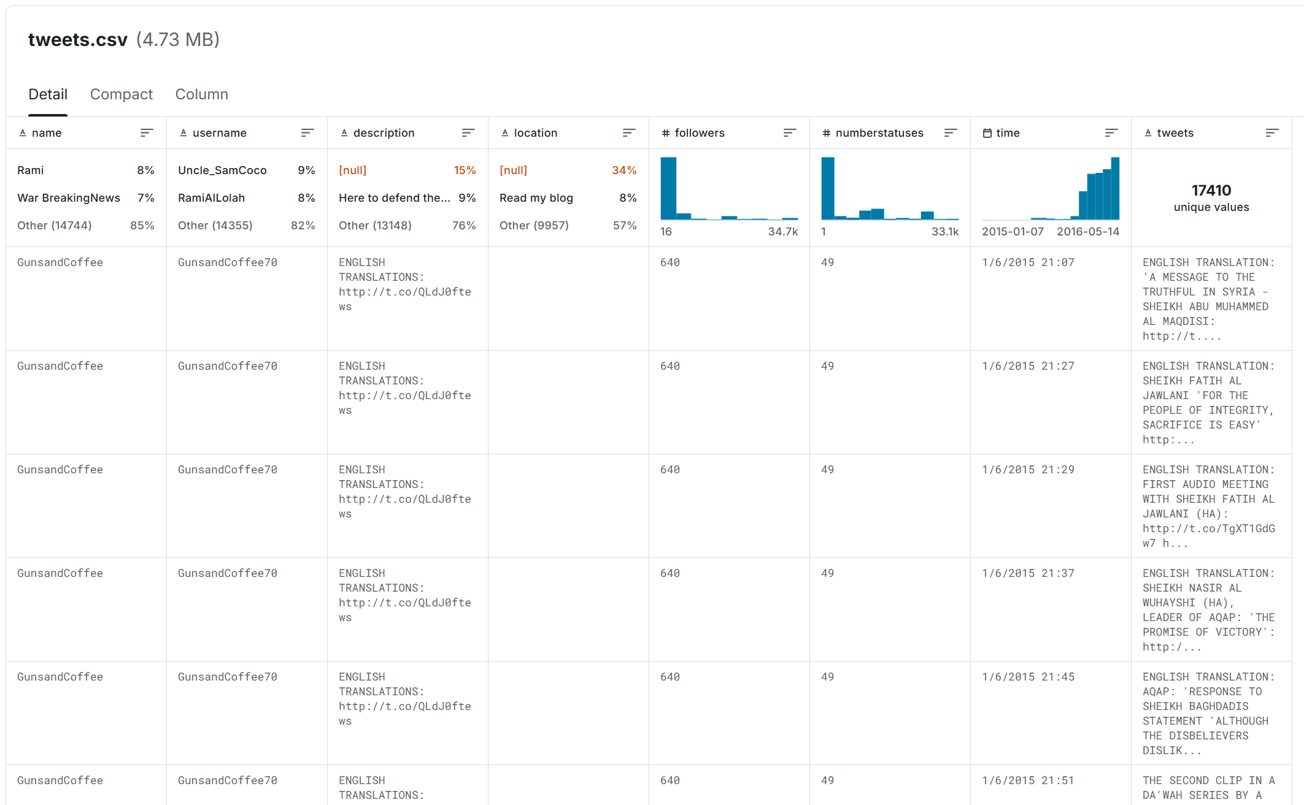

Slide 8
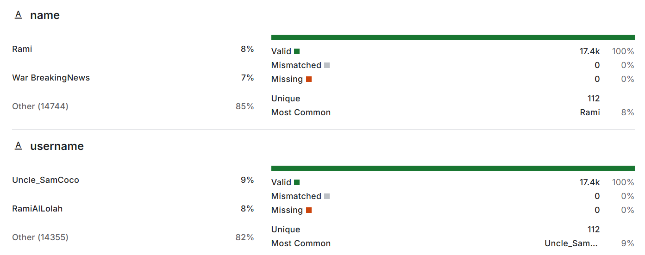
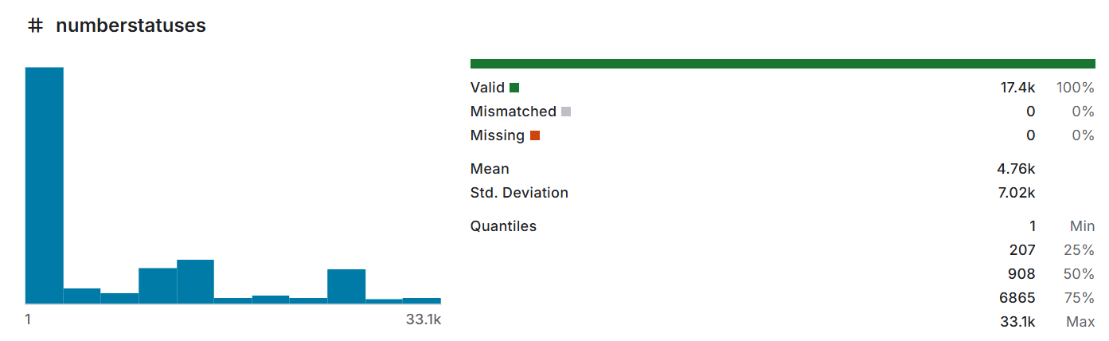
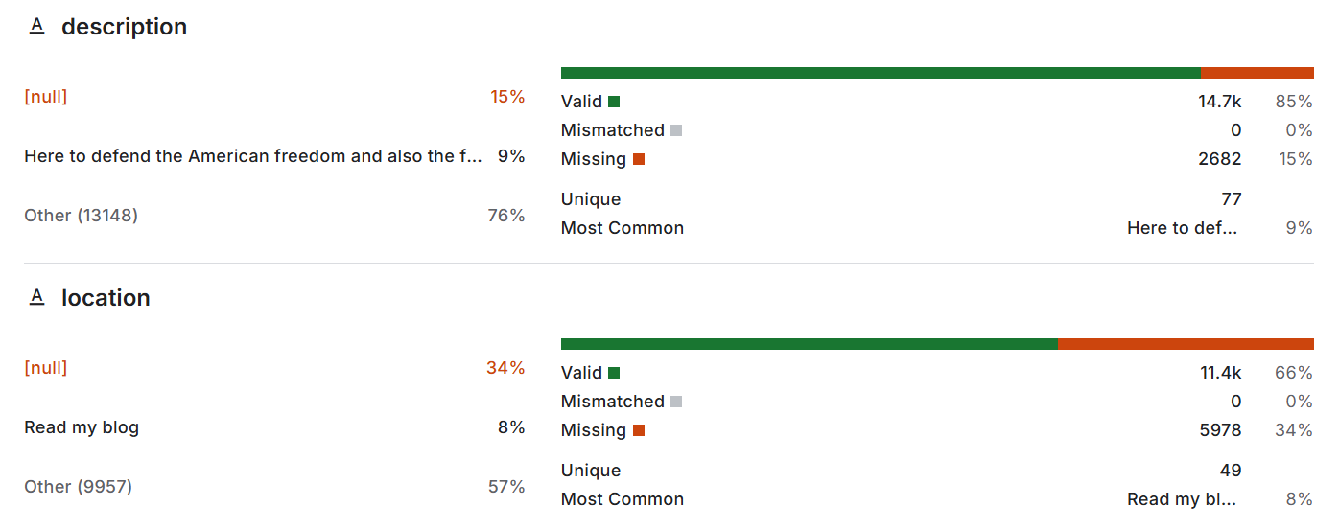
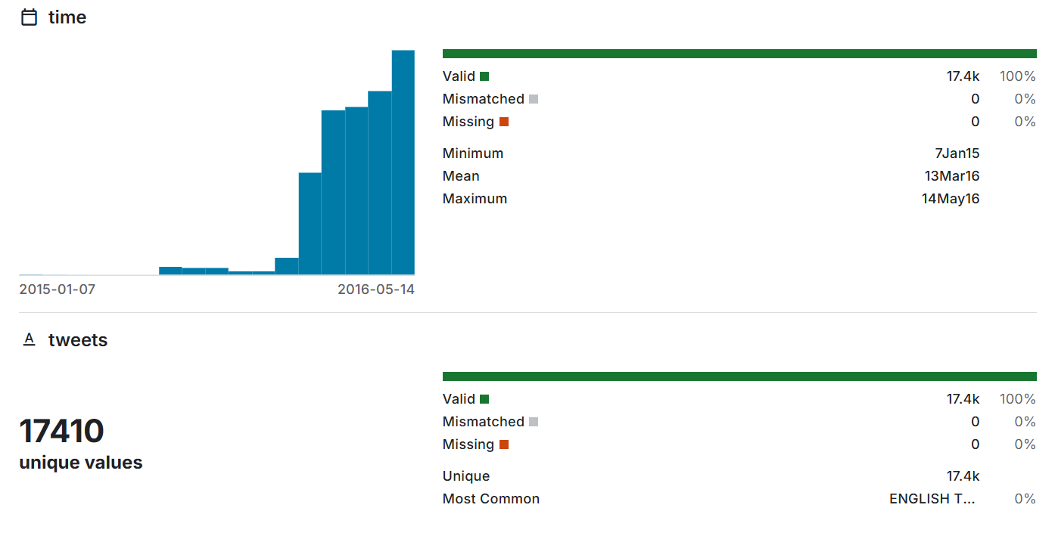
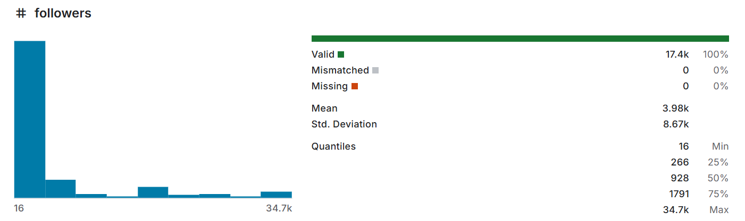

Slide 9
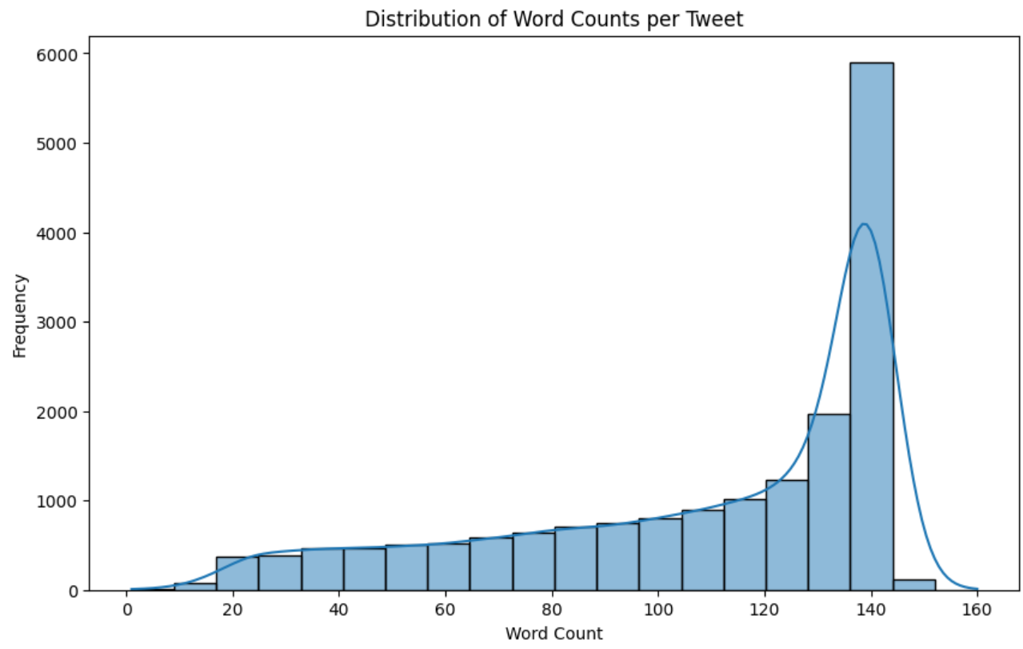
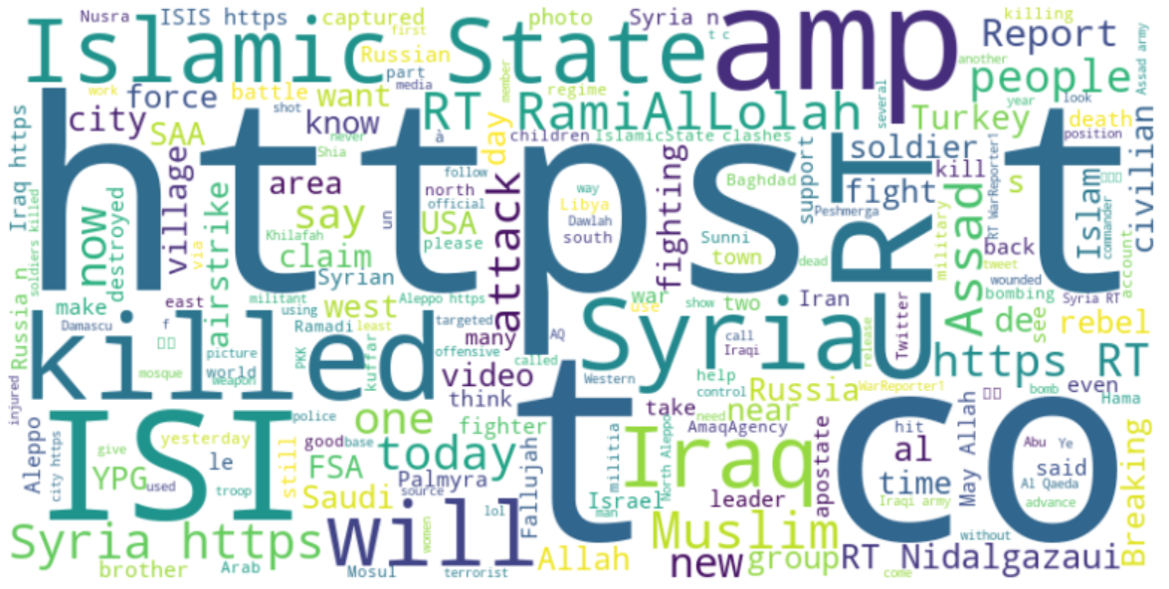
Data Preparation & Exploratory Data Analysis (EDA)

Slide 10
DATA CLEANING USING REGEX
Translation-related text: As some of the original tweets are in Arabic, the tweets that begin with “ENGLISH TRANSLATIONS” will have these words removed.
Non-alphabetic characters: Strip all non-alphabetic characters except the “#” symbol used for hashtags.
Retweet indicators, handles, and URLs: Remove "RT @", “http”, “https”, and “www”.
Unnecessary text: Remove “amp” which stands for ampersand, used as a string literal to represent “&” in the dataset.
HASHTAGS AND WORD SEPARATION
Separate hashtags from other words and capture the remaining words within the tweets.
DATA NORMALISATION THROUGH STEMMING AND LEMMATISATION
Option 1: Remove stopwords and stem words using Porter stemmer
Option 2: Remove stopwords and lemmatize words

Slide 11
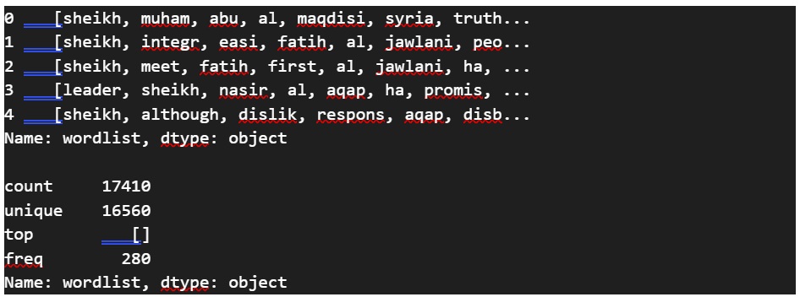
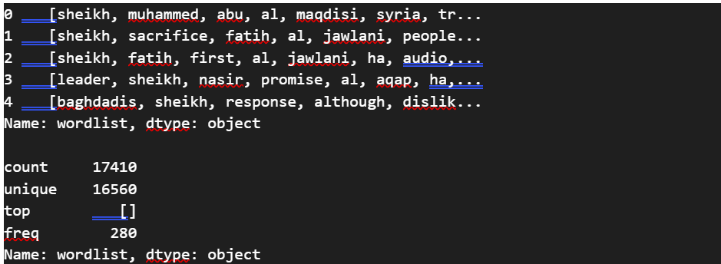
Option 1 Remove stop words and stem words using Porter stemmer
DATA NORMALISATION
Option 2 ✅
Remove stop words and lemmatize words

Slide 12
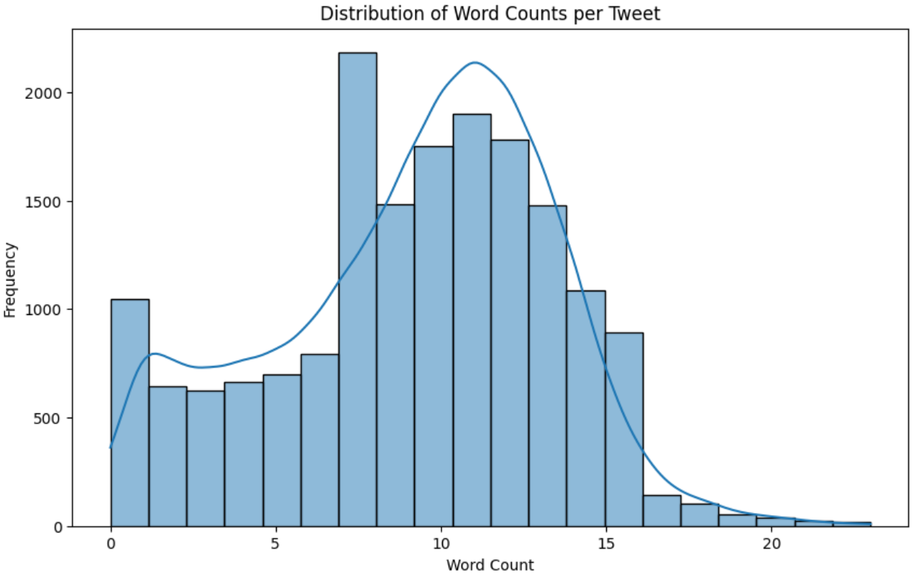
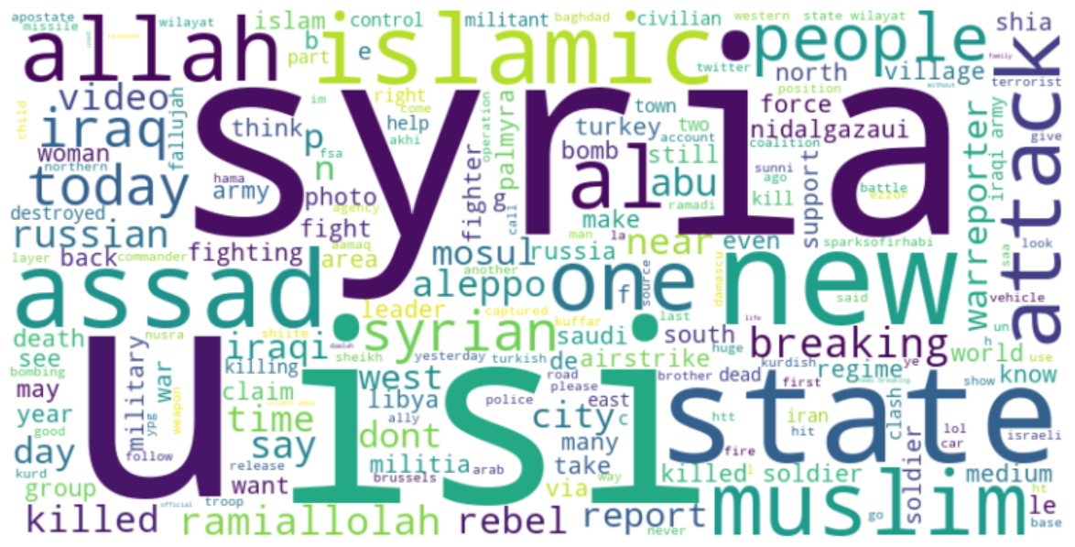
BEFORE PROCESSING
AFTER PROCESSING

Slide 13
Valence Aware Dictionary and Sentiment Reasoner (VADER)
Lexicon-based language model
Optimized for short texts like tweets.
Assigns a sentiment score ranging from -1 (most negative) to +1 (most positive), with a compound score classifying tweets as positive, neutral, or negative.
AFINN
Assigns a sentiment score to words ranging from -5 (most negative) to +5 (most positive).
Total sentiment of a tweet is calculated by summing the scores of all the words in the text.
Particularly suited for quick sentiment analysis and is straightforward in its application, making it useful for general-purpose text sentiment classification.
Bidirectional Encoder Representations from Tranformer (BERTweet)
Pre-trained transformer model designed for tweets sentiment analysis.
Unlike lexicon-based methods like VADER or AFINN, it uses deep learning to grasp the context and meaning of words within a tweet.
This model fine-tunes on a large corpus of Twitter data, making it effective in capturing complex language, including slang, acronyms, and nuanced expressions.
STEP 2: SENTIMENT ANALYSIS

Slide 14
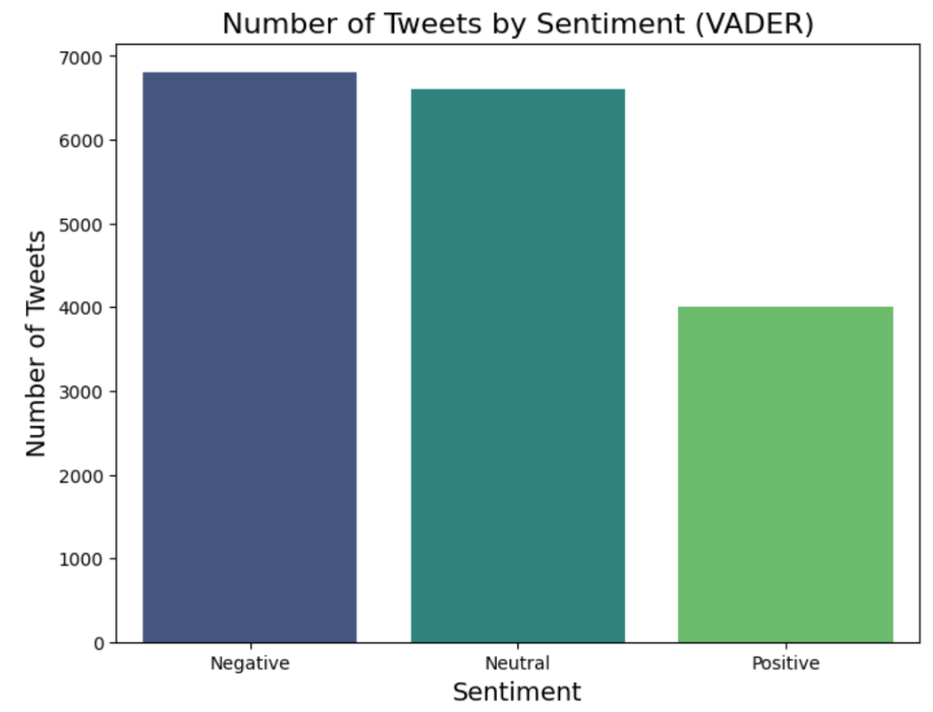
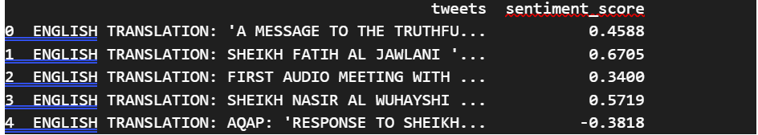
VADER Sentiment Analysis Results

Slide 15
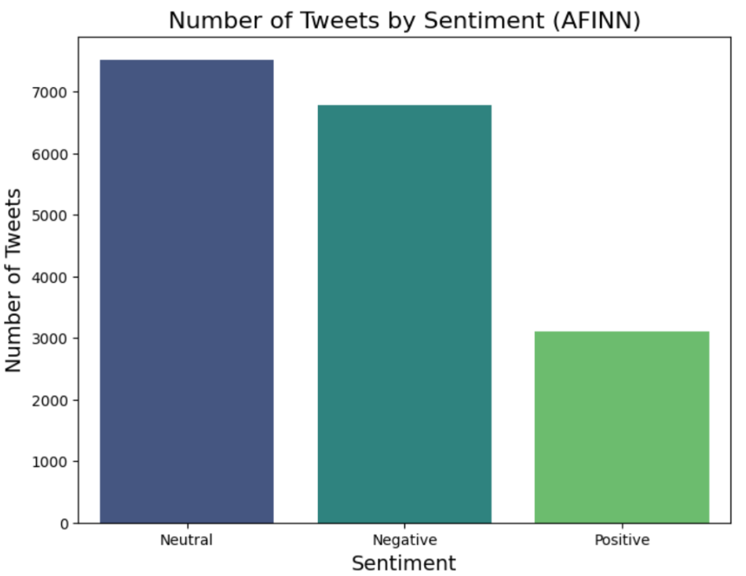
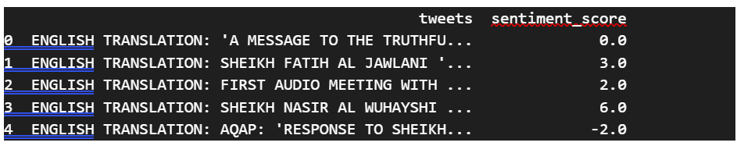
AFINN Sentiment Analysis Results

Slide 16
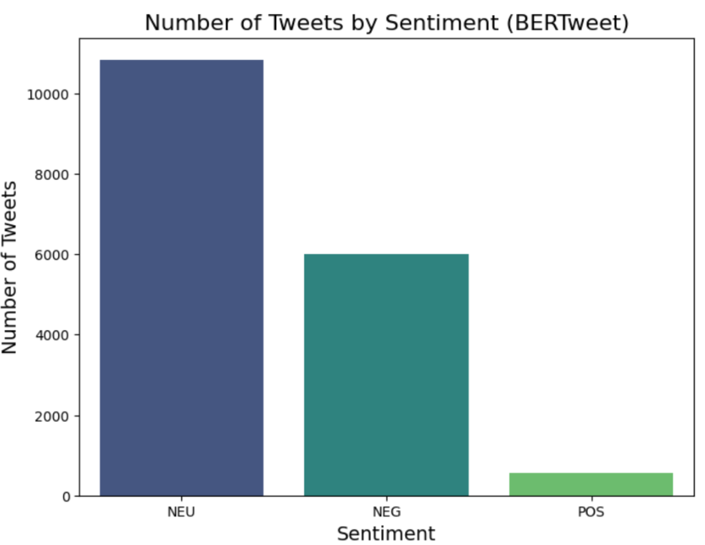
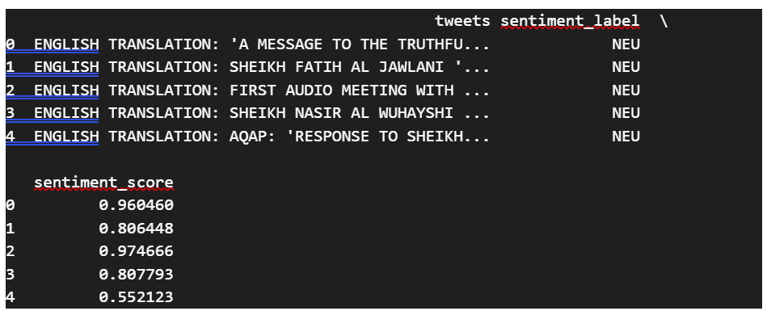
BERTweet Sentiment Analysis Results

Slide 17
Comparison Sentiment Analysis Results

Slide 18
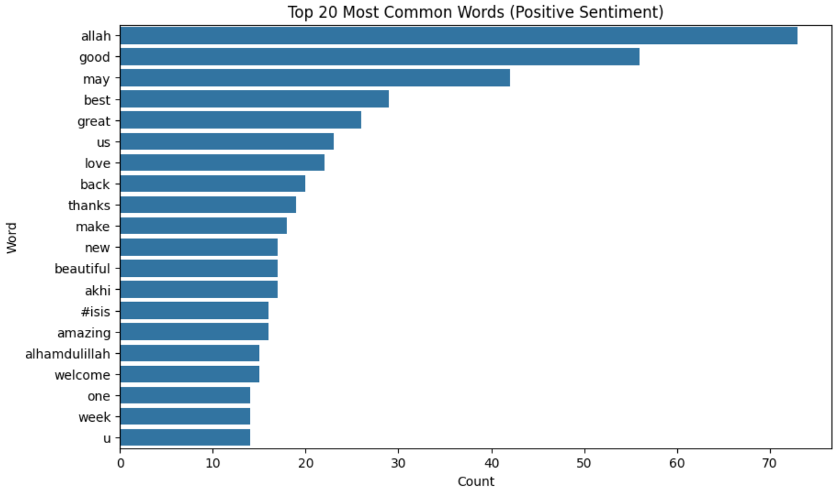
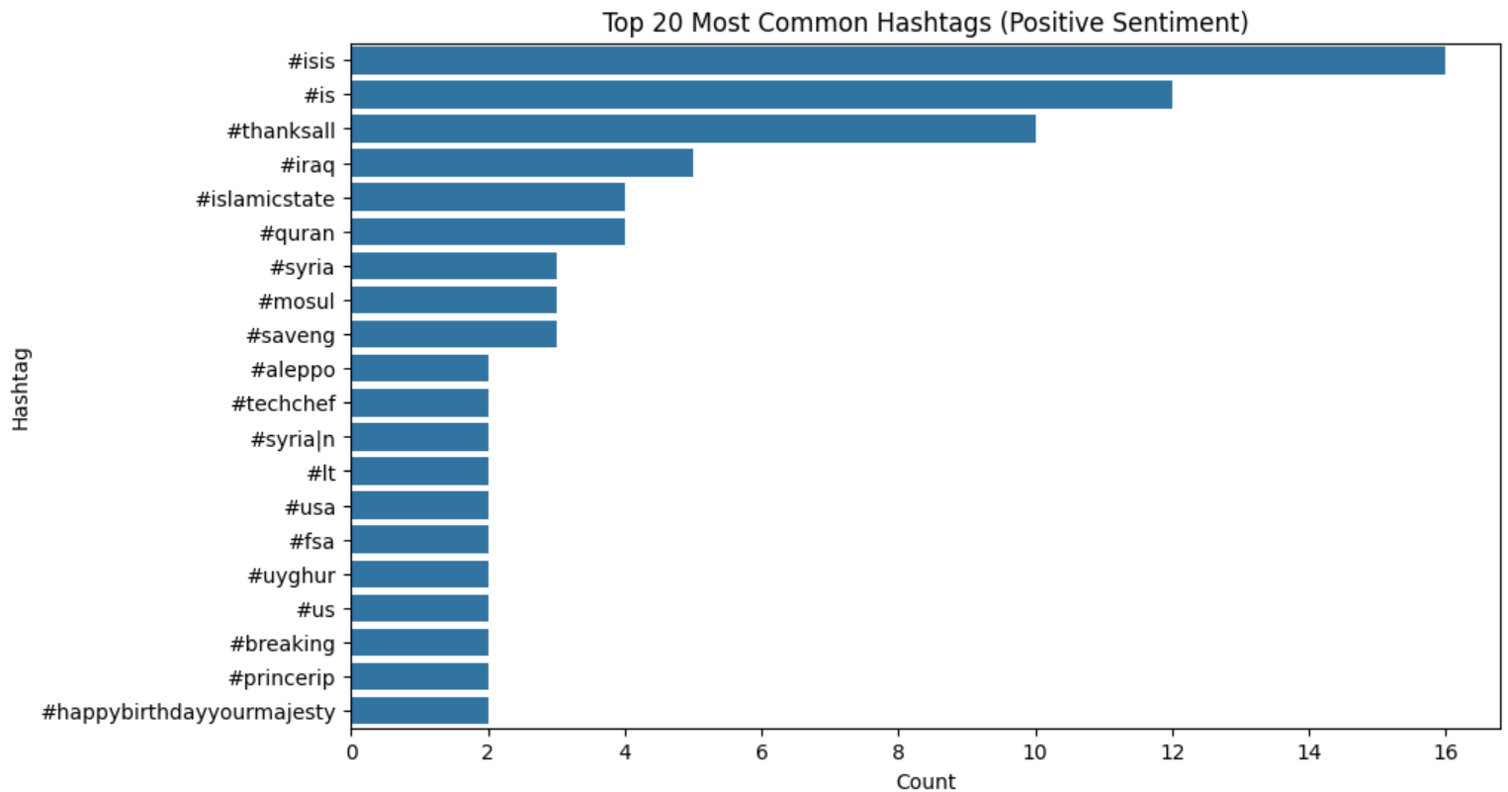
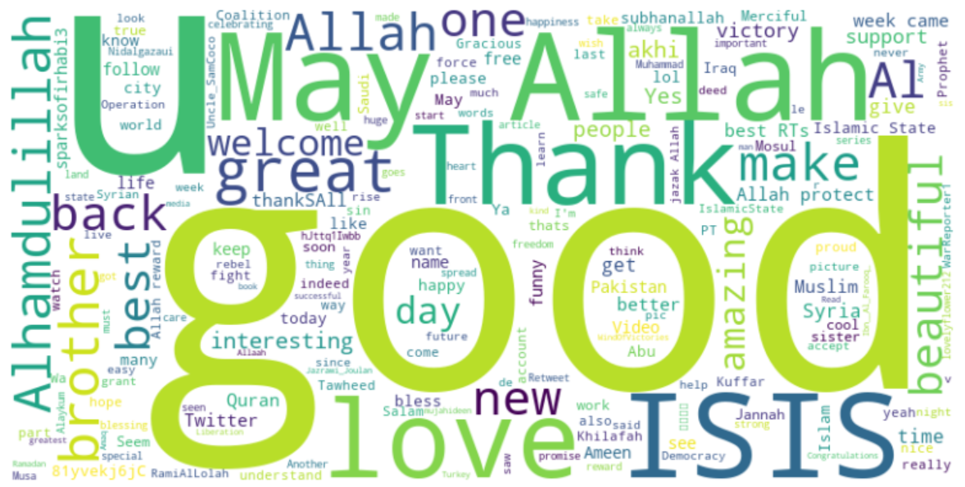
Analysis of Positive Sentiment Tweets

Slide 19
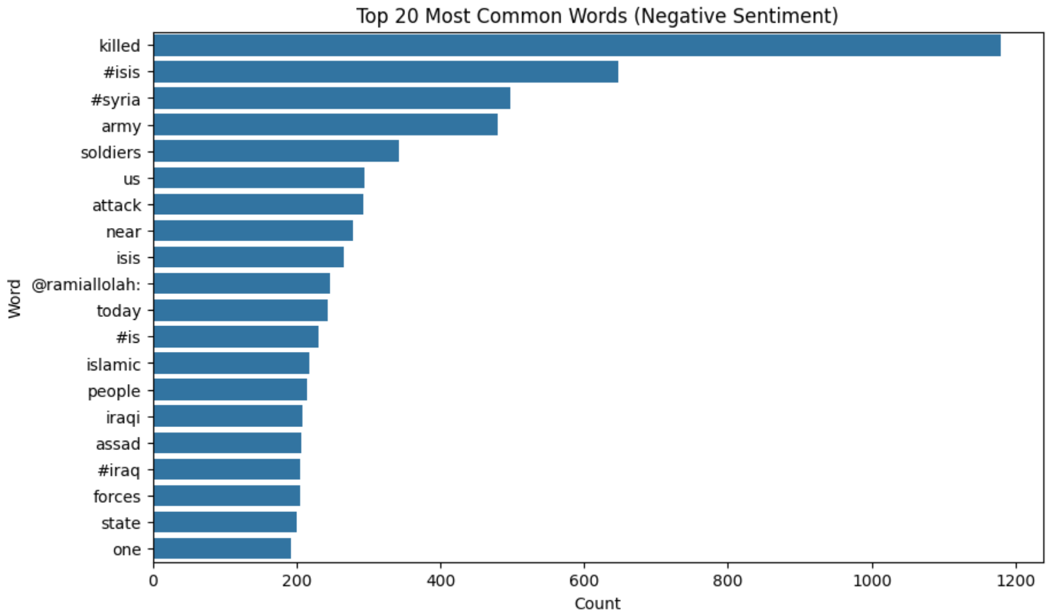
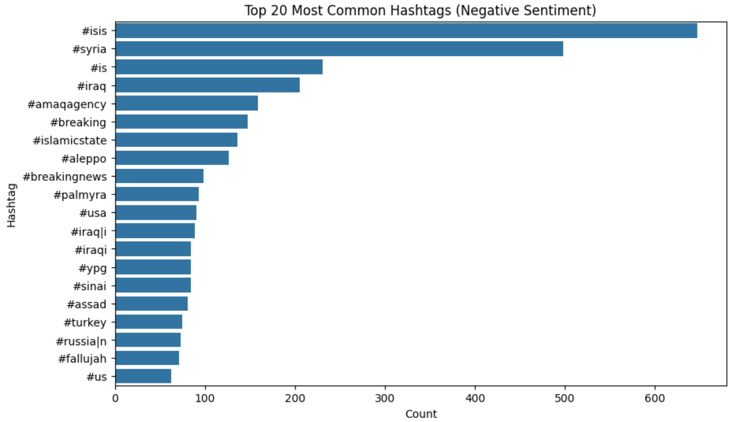
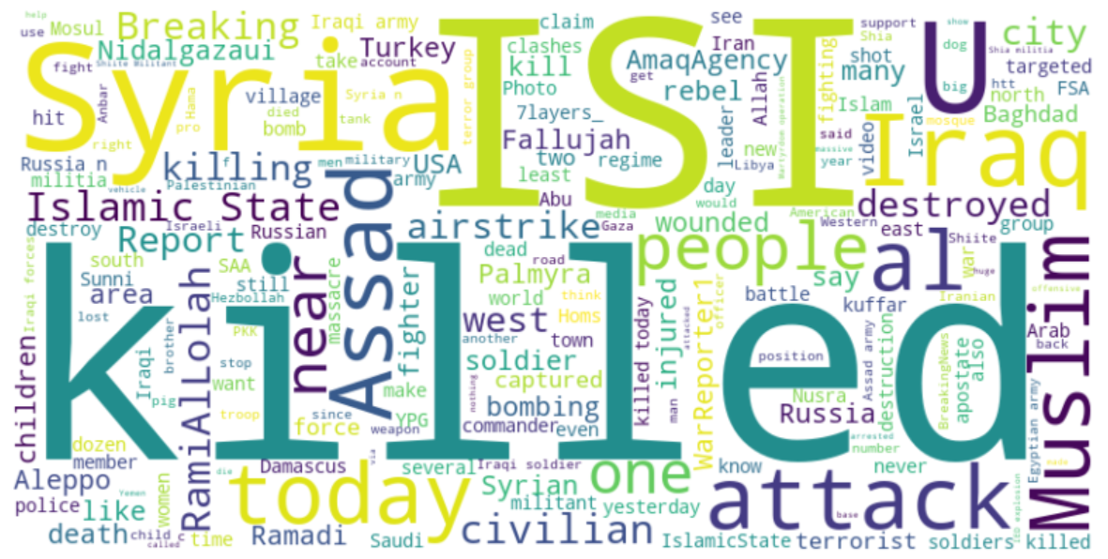
Analysis of Negative Sentiment Tweets

Slide 20
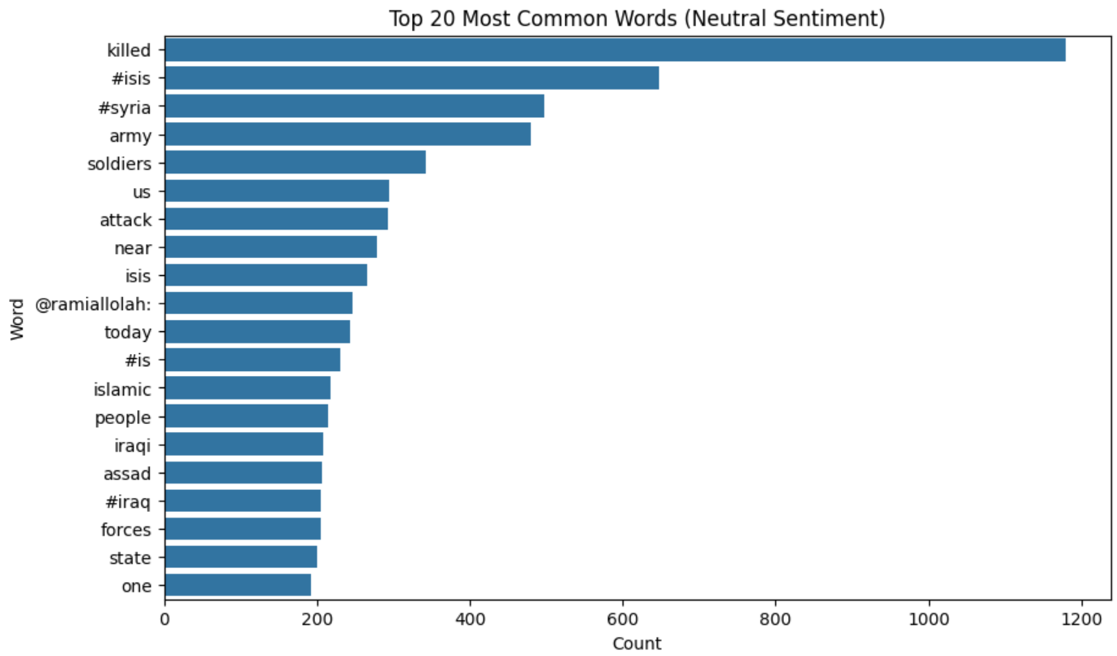
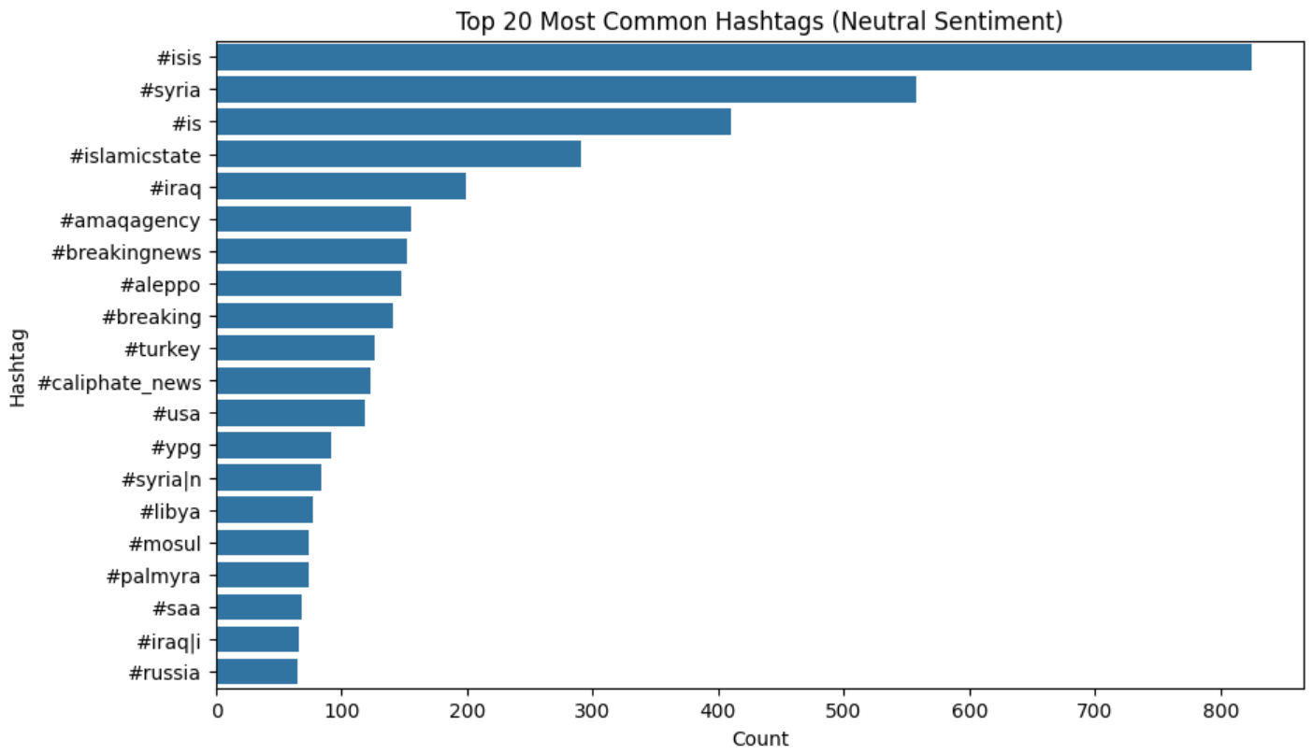
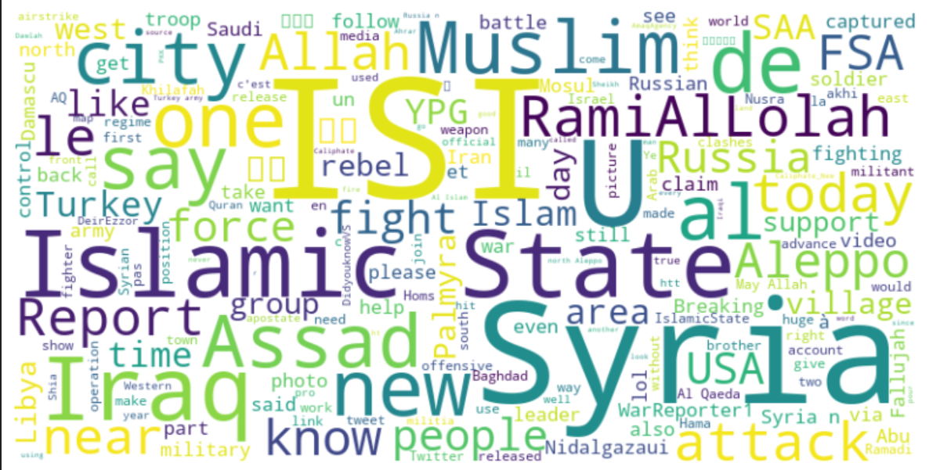
Analysis of Neutral Sentiment Tweets

Slide 21
UNSUPERVISED LDA USING GENSIM
Perform pre-processing to remove top foreign words to help align topic modelling results
STEP 3: TOPIC MODELLING
Commonly used French words biasing the topics.
Dealing with informal English used in tweets, special characters and spelling errors.
Using Gensim for Topic Modelling
Gensim is designed for unsupervised topic modeling and document similarity analysis.
After preprocessing the text, a dictionary and bag-of-words corpus is created.
LDAModel is used to extract coherent topics from the corpus.
Select optimum number of topics
Based on metrics like coherence scores and perplexity, select the optimum number of topics
Selection of number of topics can also be done based on human interpretability and overlap within topics.
Notes:
We observed that French words and informal English words used in tweets, and words with spelling errors were biasing the topic modeling results.
Hence it was necessary to clean the data and perform unsupervised LDA.
Gensim was used for Unsupervised topic modeling and document similarity. A dictionary and bag of words model was created. And the model was used to extract the topics.
We also realized that we needed to iterate to arrive at the number of topics. So we performed topic modeling iteratively to select optimum number of topics.
Online extremism: https://www.ncbi.nlm.nih.gov/pmc/articles/PMC9995191/
Online extremism is carried out in the following three ways: (1) spreading propaganda, (2) attracting youths through the recruitment messages, and (3) the radical change in the perception towards an individual or community.
ISIS seed words: https://link.springer.com/article/10.1186/s13673-019-0185-6

Slide 22
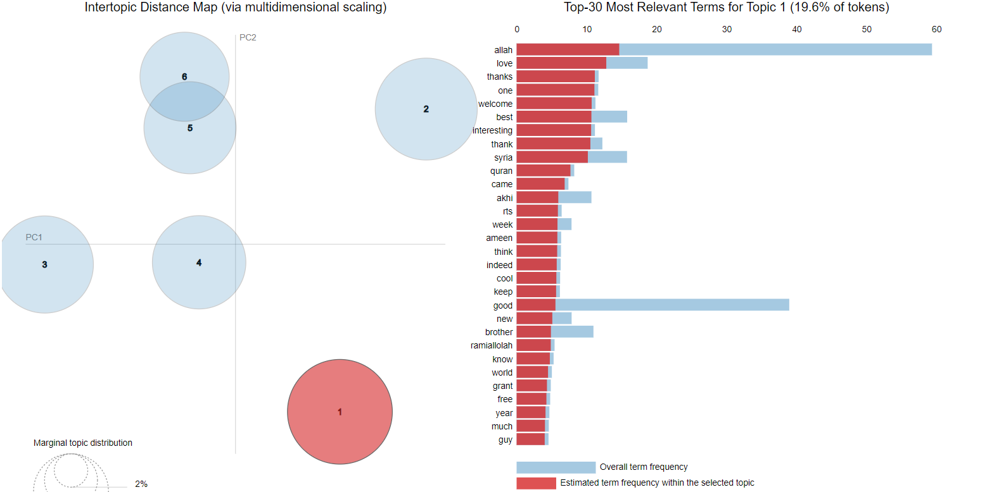
VISUALIZING RESULTS OF UNSUPERVISED LDA: POSITIVE SENTIMENT
Interpreting results of Unsupervised LDA:
The number of prominent topics can be estimated at 5-6.
Topic 1 is the most prominent in the positive sentiment tweets consuming 19.6% of tokens.
Slight overlap of tokens between topics 5 & 6
Prominent words: allah, love, thanks, one, welcome, Syria, Quran
Prominent twitter handles: ramiallolah
Notes:
Lets visualize results of the topic modelling for the unsupervised LDA.

Slide 23
SEMI-SUPERVISED LDA USING GENSIM
Need for Semi-Supervised LDA
Requirement to generate more relevant topics.
Topics generated through Unsupervised LDA contain noise.
Seeding LDA using seed topics helps steer topic generation towards relevant domains.
STEP 3: TOPIC MODELLING
Research aims
Early Detection of Extremist Messaging – Differentiating between impeding attacks and recruitment instructions
Improved Content Moderation – Differentiating radicalisation from other legitimate religious texts
Strategic Countermeasures – Identify terrorist attack targets, counter-recruitment, counter-radicalisation, labelling of at-risk person based on retweets.
Determine seed topics and seed words for all three sentiments
Based on research aims, prominent themes broadly circle Radicalization, Recruitment & Propaganda
Seed topics from each topic were identified aligning with the research aims
Seed words from the tweets corresponding to manually identified topics for each sentiment were identified for semi-supervised LDA.
Notes:
Need for semi-supervised LDA…As there was need to generate more relevant topics. And topics generated through Unsupervised LDA contained noise.
Research aims
Early Detection of Extremist Messaging.
Improved Content Moderation
Strategic countermeasures.
We aligned with these research aims and identified themes like Radicalization, Recruitment, and Propaganda.
We identified seed topics in each sentiment labelled dataset.
We used TF-IDF to look at the most important words in each sentiment labelled dataset and aligned it with the seed topics. Then we fed these as input to our model with the existing dictionary and corpus.

Slide 24
TOPIC MODELLING – SEED WORDS FOR TOPICS
Popular words used in online extremism for ISIS-related posts.
Propaganda | Radicalization | Recruitment
Arab | Matter | Bless
Massacre | Call | Counter
People | Nation | Pkk
Assadis | Destroy | Behead
America | Bullet | Believe
Apostate | Communist | Achieve
Possible | Single | Protect
Syria | Caliph | Place
Back | State | Pledge
Photographer | Realize | Point
Notes:
These were some of the common seed words we found relating to these common themes of propaganda, radicalization, and recruitment.
Popular words: https://dl.acm.org/doi/abs/10.1145/2757401.2757408

Slide 25
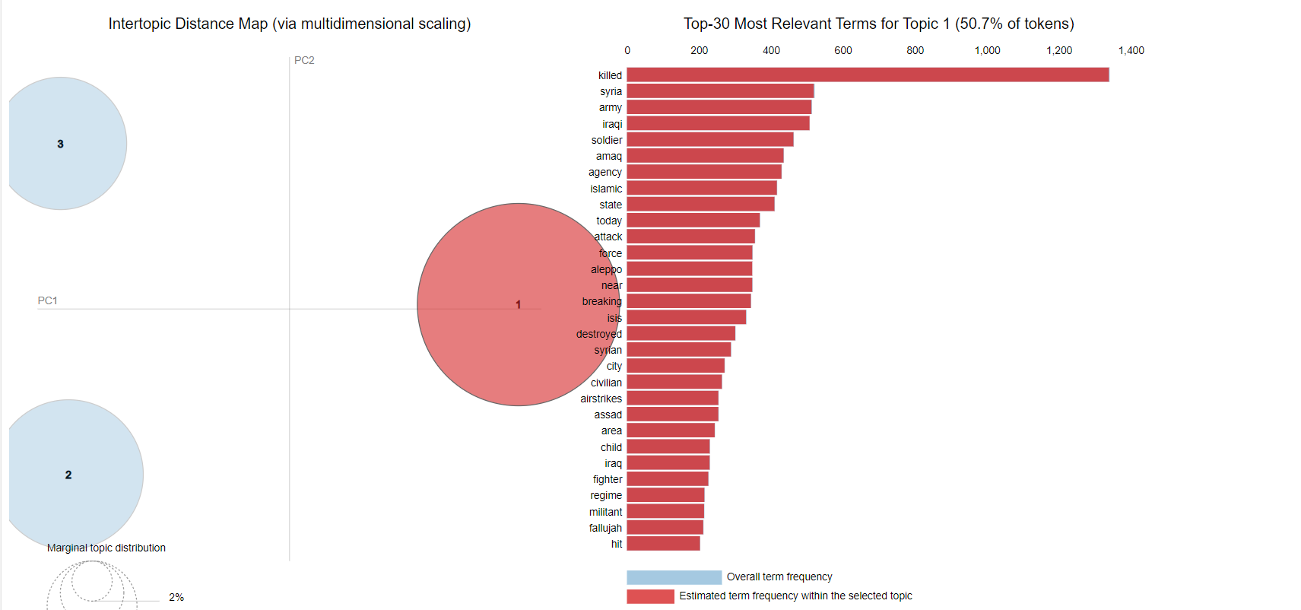
RESULTS OF SEMI-SUPERVISED LDA: NEGATIVE SENTIMENT
Seed Topic:
Terrorist Operations and Violence
Interpreting results of Semi-Supervised LDA:
Topic 1 is the most prominent topic in the negative sentiment tweets consuming 50.7% of tokens.
Manually identified seed words are top relevant terms for topic 1
Prominent words: killed, Syria, army, amaq agency, Islamic state, airstrikes
Notes:
So these are the sample results for Semi-supervised LDA for Negative Sentiment. We see that the top relevant words for topic 1 are killed, syria, army. These were also seed words for our seed topic terrorist operations and violence. Topic 1 is the most prominent topic in the negative sentiment tweets talking about terrorist operations and violence.

Slide 26
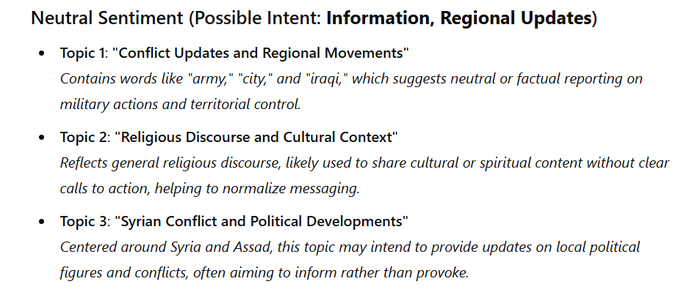
TOPIC MODELING USING GPT 4.0 : NEUTRAL SENTIMENT (SAMPLE)
Objective of topic modeling through GPT 4.0:
Assess whether the topics identified by unsupervised and semi-supervised LDA aligned with those generated by GPT-4.0.
Neutral Sentiment topics identified by GPT 4.0
Notes:
So we prompted ChatGPT to do the topic modeling for us by uploading the three sentiment-labelled datasets. The objective was to assess whether topics identified by unsupervised and semi-supervised LDA were aligned with those generated by GPT 4.0. Initially there was some noise in the topics obtained through GPT. But we reprompted it to clean the topics further and lable them for us. This is a sample for topics identified in the Neutral Sentiment dataset. We can majorly see three major topics identified in the Neutral sentiment
Conflict Updates and Regional Movements
Religious Discourse and Cultural Context.
Syrian Conflict and Political Developments.

Slide 27
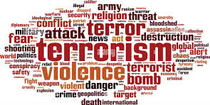
Demonstration

Slide 28
After identifying the key topics in for each sentiment-topic pair tweets.
The accounts that frequently engage with these topics will be flag for further investigation.
This will help pinpoint potential ISIS sympathizers or propaganda sources.
STEP 4: ANALYSIS

Slide 29
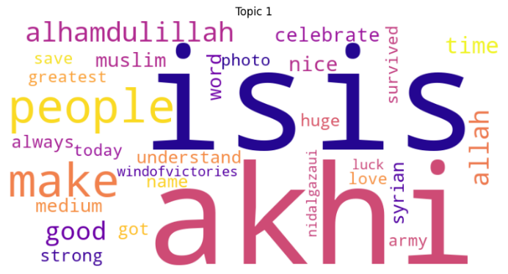
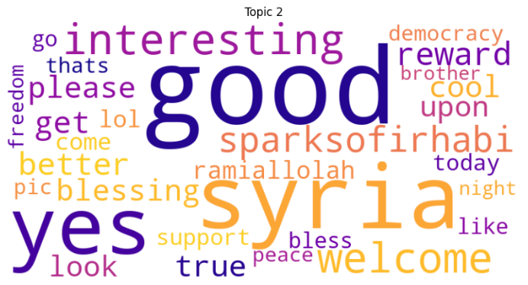
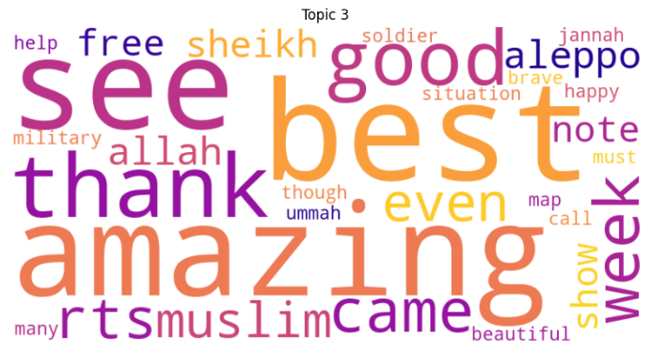
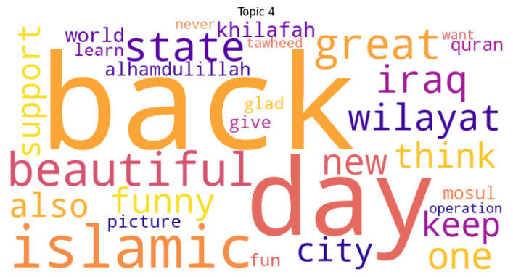
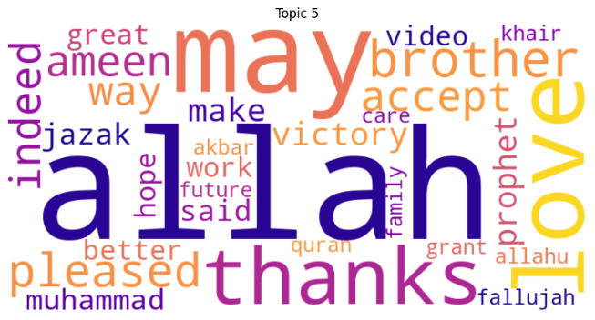
SEMI-SUPERVISED LDA POSITIVE
TOPIC 1
Faith and Resilience in Challenging Times
TOPIC 2
Social Media Engagement and Global Events
TOPIC 3
Expressions of Faith, Support, and Community Connection
TOPIC 4
Expressions of Positivity, Resilience, and Support
TOPIC 5
Expressions of Faith, Respect, Understanding

Slide 30
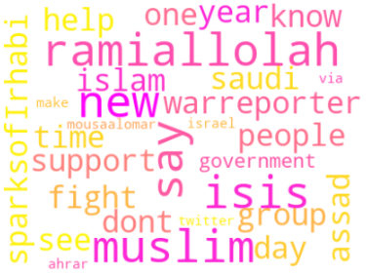
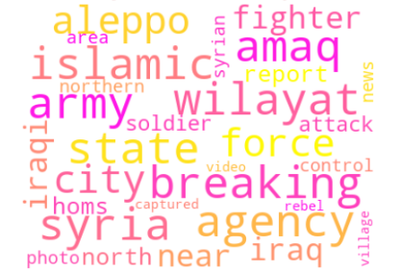
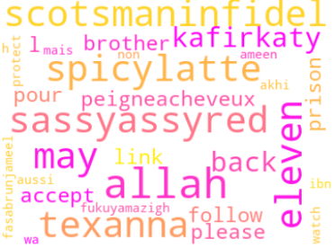
SEMI-SUPERVISED LDA NEUTRAL
TOPIC 1
Support and Group Dynamics
TOPIC 2
Military and Territorial Updates
TOPIC 3
Religious and Social

Slide 31
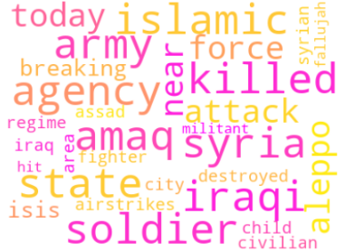
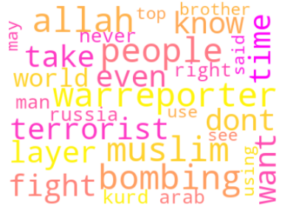
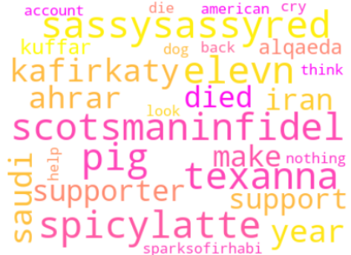
SEMI-SUPERVISED LDA NEGATIVE
TOPIC 1
Military Conflict during Attacks
TOPIC 2
Civilian Casualties from Terrorism Activities
TOPIC 3
Ideological Influenced Regime Battles

Slide 32
Sentiment-topic pair POSITIVE
Topic No. | Unsupervised LDA | Semi-Supervised LDA | LLM (ChatGPT)
1 | Religious and Spiritual Expressions | Faith and Resilience in Challenging Times | Religious Unity and Moral Justification
2 | Positivity and Brotherhood | Social Media Engagement and Global Events | State-Building and Ideological Goals
3 | Hope and Progress | Expressions of Faith, Support, and Community Connection | Military Power and Regional Influence
4 | Support and Celebration | Expressions of Positivity, Resilience, and Support | Martyrdom and Heroism
5 | Community and Pride | Faith, Respect, and Understanding | Community Engagement and Recruitment Appeals
6 | Enthusiasm and Leadership

Slide 33
ANALYSIS OF SENTIMENT-TOPIC ACROSS 3 METHODS
Positive Sentiment
Religious expressions, non-violent but supportive messaging
Negative words like martyrdom pairing with heroism.
Largely for propaganda and recruitment purposes.
Neutral Sentiment
Converge on practical updates, like statements and updates on group’s activities.
Narratives are factual in nature, positioning the group’s activities within a broader geopolitical context. West against ISIS.
Topics may not invoke strong emotions from the audience
Negative Sentiment
Converge along the line of military conflict, civilian impact with emotionally charged language.
Suggest elements of radicalisation and fostering hostility.
Focus on casualties and opposition creates a victim-persecutor dynamic, potentially appealing to individuals sympathetic to militant causes.

Slide 34
BUSINESS USE-CASE ANALYSIS
Positive Sentiment
Identify subtle propaganda and monitor recruitment messaging
Flag clusters frequently using these terms to detect non-violent support for extremist ideologies.
Neutral Sentiment
Assess geographic areas of interest to extremists.
Distinguish legitimate news from covert propaganda for improved content moderation.
Negative Sentiment
Track radicalisation hotspots and recruitment points.
Assess areas with increased civilian impact and allocate resources effectively.

Slide 35
PRACTICAL APPLICATIONS
Business Use Case | Positive | Neutral | Negative
Content Moderation | ✔ | ✔ | ✔
Early Detection of Extremist Messaging | ✔ | ✔ | ✔
Tracking Recruitment Indicators | ✔ |  | ✔
Monitoring Morale and Ideological Support | ✔ | ✔
Real-time Crisis Monitoring for Humanitarian Aid |  | ✔ | ✔
Geopolitical Analysis and Risk Assessment |  | ✔ | ✔
Identifying Key Influencers and Networks | ✔ | ✔ | ✔
Strategic Countermeasures for Intelligence Agencies | ✔ | ✔ | ✔

Slide 36
SEMI-SUPERVISED vs. UNSUPERVISED LDA
PERPLEXITY AND COHERENCE SCORES
Perplexity
positive
neutral
negative
-8.00
-9.32
-8.45
UNSUPERVISED
positive
neutral
negative
3.21
-5.26
-5.17
SEMI- SUPERVISED
Notes:
This table shows the results of the metrics we used specifically perplexity and coherence scores, for each sentiment.
a lower perplexity score indicates a better fit to the data, meaning the topics generated by the model more accurately represent the text data.
In the Unsupervised LDA model, negative perplexity scores for all sentiments indicate a relatively good fit, with the "Neutral" sentiment having a better score (-9.32), than the others.
In the Semi-Supervised LDA model, the perplexity scores are higher and positive for the "Positive" sentiment, but lower for the "Neutral" and "Negative" sentiments, which suggests that the model struggles more with fitting the data compared to the Unsupervised LDA model.

Slide 37
SEMI-SUPERVISED vs. UNSUPERVISED LDA
PERPLEXITY AND COHERENCE SCORES
Coherence Scores
positive
neutral
negative
0.60
0.36
0.38
UNSUPERVISED
positive
neutral
negative
0.56
0.42
0.35
SEMI- SUPERVISED
Notes:
COHERENCE SCORES
On the other hand, higher coherence scores suggest that the topics make more sense to human readers because the words within each topic are more closely related.
For both models, the "Positive" sentiment shows the highest coherence scores which means positive topics are the most interpretable and cohesive.
In the Unsupervised LDA model, the "Positive" coherence score is 0.60, higher than both "Neutral" and "Negative."
The Semi-Supervised LDA model has a slightly lower coherence score for "Positive" at 0.56 but performs similarly to the Unsupervised LDA model.
Overall, the Unsupervised LDA model performs better in terms of perplexity, while both models show comparable coherence scores.

Slide 38


CONCLUSION & FURTHER WORK
LANGUAGE IDENTIFICATION AND TRANSLATION
COMPARATIVE ANALYSIS OF PRO-ISIS VS. ANTI-ISIS CONTENT
CURRENT LIMITATION:
French words were overlooked due to their use of the same alphabet as English and Arabic words
CURRENT FOCUS:
This analysis was limited to tweets from ISIS supporters.
FUTURE STUDY:
Compare pro-ISIS and anti-ISIS sentiment-topic pairs to differentiate between user groups. This would assist content moderators in identifying key accounts for information dissemination within each group, especially for targeting central nodes effectively.
FUTURE IMPROVEMENT:
Implement language detection to accurately identify and translate multiple languages
Notes:
CONCLUSION
We did not consider the French as the translation from predominantly Arabic words into English missed the French words which also uses alphabets. And as such they were not considered in our analysis.
What could be done in future studies is to properly identify the different languages and be deliberate about the translation.
For this analysis, we only used ISIS supporter tweets.
In future works, study can be done to compare pro-ISIS against anti-ISIS sentiment-topic pair to have a clear differentiation between the two groups of users so that the content moderators can get the correct accounts as the central nodes for information dissemination.

Slide 39

Thank you!
Any questions?

Slide 40
GROUP REFLECTION
Lack of expertise in selecting seed words for semi-supervised LDA
1
Decision on treatment of foreign language.
2
Notes:
Since most team members may not be familiar with the topics of ISIS and terrorism, certain keywords with significant contextual meanings may not be captured effectively. This can lead to an incomplete representation of the intended topics, as key terms are missed during seed word identification and allocation.
Next is our decision on how to handle foreign language content. While removing foreign language text from the corpus may seem simplest, it risks excluding words with significant meaning. Moreover, using general machine translation for specific topics like terrorism may not yield ideal results, as nuances in terminology may be lost.

Slide 41
Individual Reflection for Submission Only

Slide 42
LORIELLE'S REFLECTION
Contributions
LDA Topic Modelling
Assisted the team in implementing the LDA model pipeline, including determining the optimal number of topics and topic labels and performing model evaluations.
Report & Presentation
Contributed to sections on LDA topic modeling and conclusions in the project proposal and report.
Created and refined presentation slides to clearly convey findings and conclusions.
Key Learnings
Researching Cultural and Contextual Nuances:
Gained insight into the importance of understanding cultural terminology and specific jargon used in topics related to ISIS and its geographical context.
Model Comparison & Evaluation:
Developed skills in evaluating both supervised and unsupervised LDA topic modeling approaches, using coherence and perplexity scores to assess model quality and effectiveness.
Text Analytics Insights
Gained valuable insights into the power of text analytics through our group project, specifically in analyzing and extracting meaningful patterns from the ISIS tweets dataset.

Slide 43
SHAO FEI'S REFLECTION
Contributions
Exploratory Data Analysis (EDA)
Conducted EDA on the dataset both before and after preprocessing to understand data patterns, structure, and issues.
Used visualizations and summary statistics to inform cleaning and preprocessing steps.
Sentiment Analysis Implementation
Developed sentiment analysis pipeline using VADER, AFINN, and BERTweet models to assess sentiment in ISIS-related tweets.
Ran experiments to evaluate and compare sentiment results across models, analyzing performance metrics for accuracy and consistency.
LDA Topic Modelling
Supported team in implementing LDA model pipeline.
Report & Presentation
Contributed to writing sections in the project proposal and report on data pre-processing and sentiment analysis.
Created and refined slides to present EDA findings, sentiment analysis results, and project insights clearly.
Key Learnings
Importance of EDA:
Recognized the critical role of EDA in identifying data quality issues and guiding preprocessing step.
Model Comparison & Evaluation:
Learned to evaluate the differences of rule-based vs. deep learning approaches in sentiment analysis.
Collaboration in Problem-Solving:
Appreciated the synergy of diverse skills within the team to tackle complex project challenges.

Slide 44
SARTHAK'S REFLECTION
Contributions
Preprocessing the tweets for Topic Modelling
Preprocessed the tweets to deal with stop words and most common foreign words so that they don't skew topic modelling results
Implementation of Unsupervised and Semi-Supervised LDA using Gensim for Topic Modelling
Report & Presentation
Contributed to writing sections in the project report and presentation slides on experiment design: unsupervised and semi-supervised topic modelling.
Key Learnings
Importance of data quality for topic modeling:
Recognized the critical role of data preprocessing in identifying the most significant topics.
Importance of the number of topics in topic modelling:
Selection of the optimum number of topics is crucial for the topics obtained to be distinct and interpretable.
Collaboration in Problem-Solving:
Collaborated with the team to identify key use cases, and solve problems encountered during the project..
Implemented Unsupervised LDA for positive, negative and neutral sentiment tweets using gensim.
Created Visualizations to view the results of the Unsupervised and Semi-Supervised LDA using pyLDAvis to helping identify key topics.
Incorporated seed topics and seed words proposed by other team members to implement Semi-supervised LDA on positive, negative and neutral sentiment tweets.
Selecting appropriate seed topics and seed words can help bias the LDA model to identify more relevant topics and reduce noise.
Importance of selection of seed topics and seed words in semi-supervised LDA:

Slide 45
XIUHAO'S REFLECTION
Contributions
Leadership
Organised the team and allocated task
Implementation of Unsupervised and Semi-Supervised LDA for Topic Modeling
Key Learnings
Collaboration
Recognized the different skills each member bring to the table
Came up with the Business use cases and write up
Did up the write up on the business and practical applications of the findings for neutral words for both Semi and Unsupervised LDA models.
Did the comparison and Analysis of the Semi and Unsupervised LDA for Topic Modeling and their use cases
Report and Presentation
Came up with the framework for the report and PPT and populated the contents
Willingness to crack our heads together when we ran into some difficulties with the supervised LDA model.

Slide 46
Cheng En's Reflection
Contributions
Sentiment Analysis Implementation
Key Learnings
Collaboration
Did up TF-IDF seed words from each sentiment for the semi-supervised LDA model
Report and Presentation
Assisted with the write up of the results
LDA Topic Modeling
Assisted with coming up with Business use cases and topics
Did up the write up on the business and practical applications of the findings for neutral words for both Semi and Unsupervised LDA models.
Stitched up the various parts and rewrote sections to ensure that they comply within the page limits.
Even as we collaborated, not everyone had a clear full picture of what was going on and were working in silos for their parts and task therefore the need for cross-sharing and learning.
Sentimental Analysis
The use of different models even under the context of no ground truth and how the models can be applicable to our study of sentiment at the workplace.
Semi-supervised VS Unsupervised models
The need for seed words and seed topics in text analytics models and even with those it is still only semi-supervised.

Slide 47
WEI JUN'S REFLECTION
Contributions
Sentiment Analysis Implementation
Key Learnings
Diversity & Inclusivity
Did up TF-IDF seed words from negative sentiment for both the semi-supervised and unsupervised LDA model
Report and Presentation
Assisted with summarizing the write-up of sentiment analysis implementation write up and results of the draft and final report submission
LDA Topic Modeling
Contributed with coming up with business use cases and topics related to all senntiments
Did up the write up on the business and practical applications of the findings for negative sentiments for both semi-supervised and unsupervised LDA models.
Wrote up the proposal in key points of the sentiment analysis description, the use cases, results from all sentiments for supervised and unsupervised LDA and fixed the format and a first cut of reduction of pages. The word cloud for the presentation slides on semi-supervised LDA.
Every team member has different backgrounds in work experiences and brings a different skillsets and technical levels to the table across different MITB tracks. Despite this, we collaborated and coordinated well to tackle roadblocks along the way eg. when we were considering whether to use supervised LDA learning method whereby the training model will require very high GPU and computational resources to run the codes in python. We ultimately came to a common consensus to push on with the idea and throughout the project each of us worked on separate parts of the project deliverables to our strengths.
Importance of Topic Modelling
The crafting of each topic resonates with life scenario and once set in stone can be used as a point of guidance for us to proceed with subsequent steps of our report and the topics can be used in the workspace by one of our groupmate and it was an educational journey for someone like me who isn't familiar with this topic at all through our project discussions and every task execution.
Text Analytics on a Sensitive Subject
We were initially reluctant to select this topic on analyzing 15,000+ tweets from ISIS which are not always in English language and with various different contexts that we don't really understand and have limited knowledge in. Additionally, because most of us group members do not have much idea or insights about the subject matter but after some consideration and prolonged discussion about whether to proceed with this topic with limited understanding, we decided to take on this difficult challenge and go ahead with working on this subject because ultimately apart from one of our group member working on such a solution in the work place, personally I feel it's something I am curious about and would like to learn more and deep dive further given the opportunity.

